Slide 1
Enhance Your Life and World:
Be Aware of Your Environment!

Slide 2
Not Beware
of Your Environment!

Slide 3
Be Aware
of Your Environment!
If you look more carefully,
you will see more!
If you listen more carefully,
you will hear more!
Using Bird Song as an Example.

Slide 4
A Main Objective of this program
is to help you
Train Your Brain
To be More Observant!

Slide 5

The nature of sound:
Sound is transmitted through the air
as a disturbance of molecules.
No sound in a vacuum.
Note regions of compression and regions of rarefaction.

Slide 6
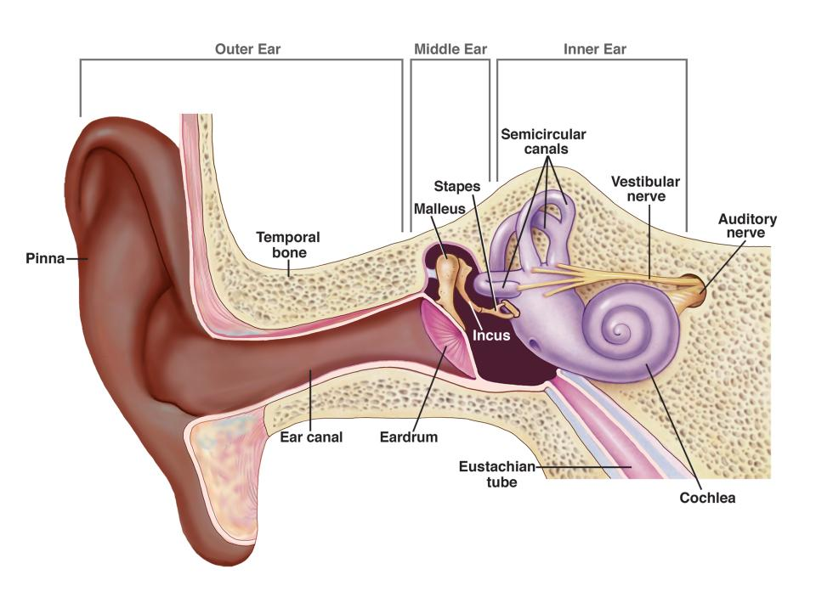
The disturbed air molecules hit
and vibrate the eardrum - - - - -

Slide 7
Functions of Bird Calls and Songs
Establish a territory.
Identify same species to each other.
Attract a mate.
Reveal its sex in species where the two sexes look similar to each other.
Stimulate and synchronize courtship behavior.

Slide 8
6. Maintain the pair bond over time.
7. Signal changes in duties, e.g., take over incubation duties.
8. Young and parents identify each other by calls and song.
9. Coordinate flock movements.
10. Intimidate and scare predators.
11. Warning about the approach of
a predator.

Slide 9
You can train
your brain
to listen more carefully
for details!

Slide 10
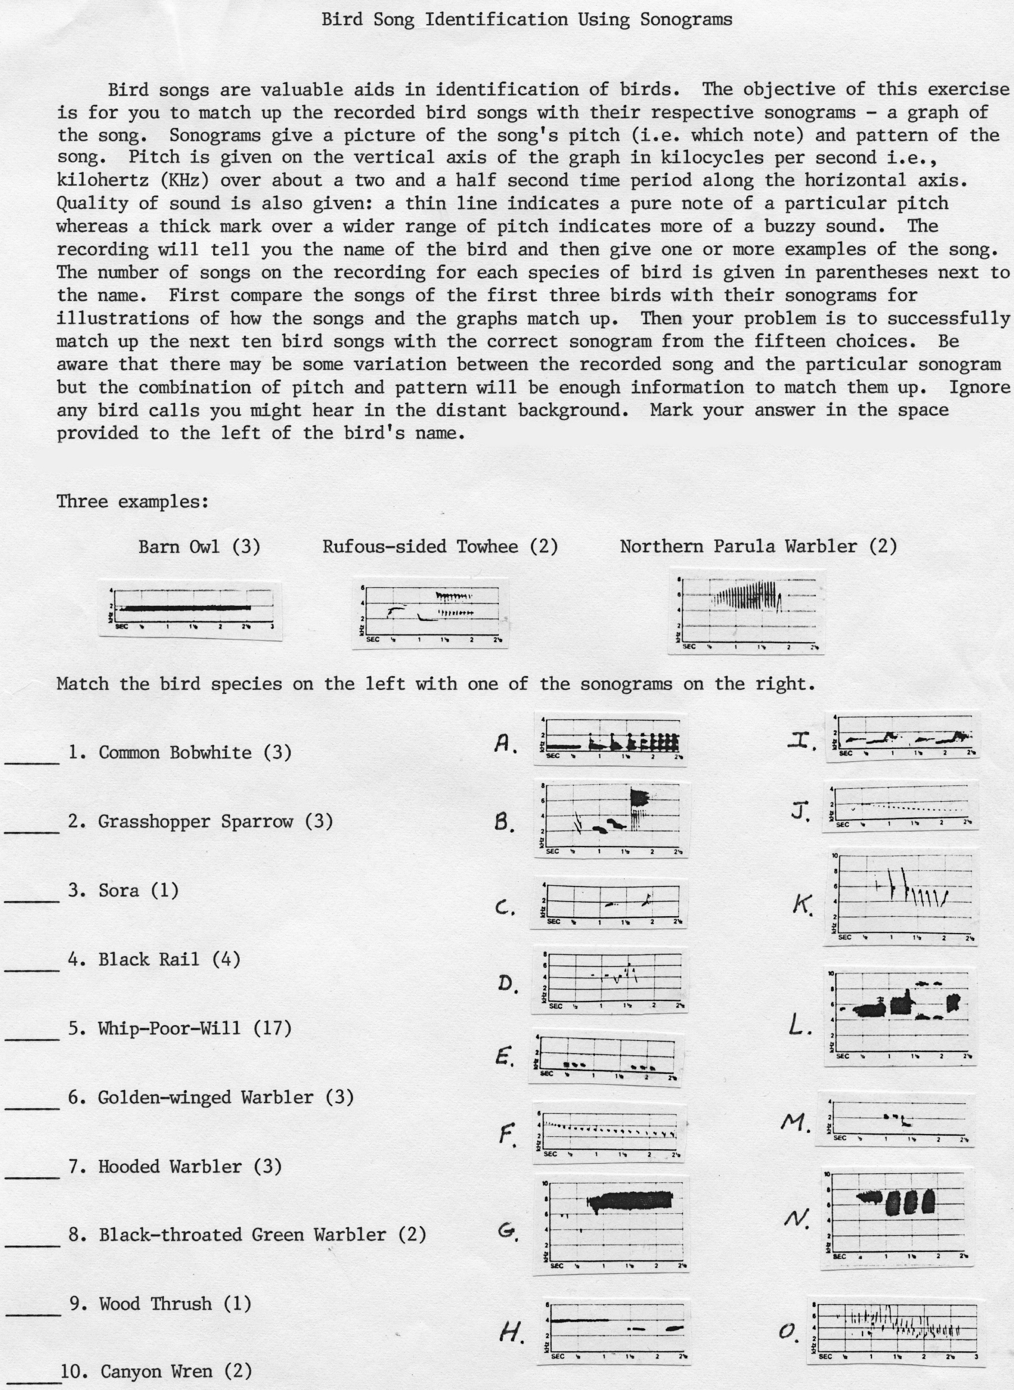
Note the handout instructions
- but stop after two sentences.

Slide 11
A note on the term “sonogram:”
A SPECTROGRAM is a visual
representation of the spectrum
of frequencies of a signal as it
varies over time.

Slide 12
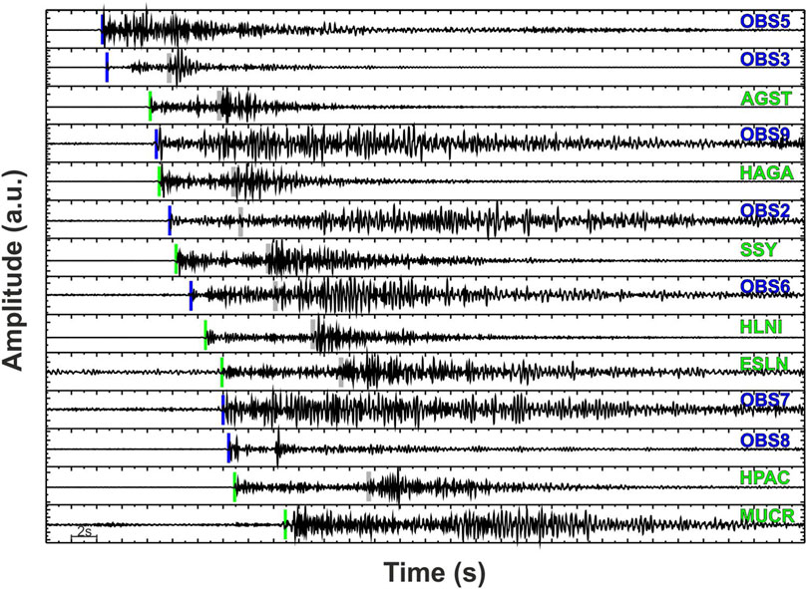
Not only can a spectrogram be generated by sound - but also, for example, by an earthquake:
October 23, 2017 Mediterranean Locations
Notes:
a.u. means “arbitrary unit” of vibrations over time

Slide 13
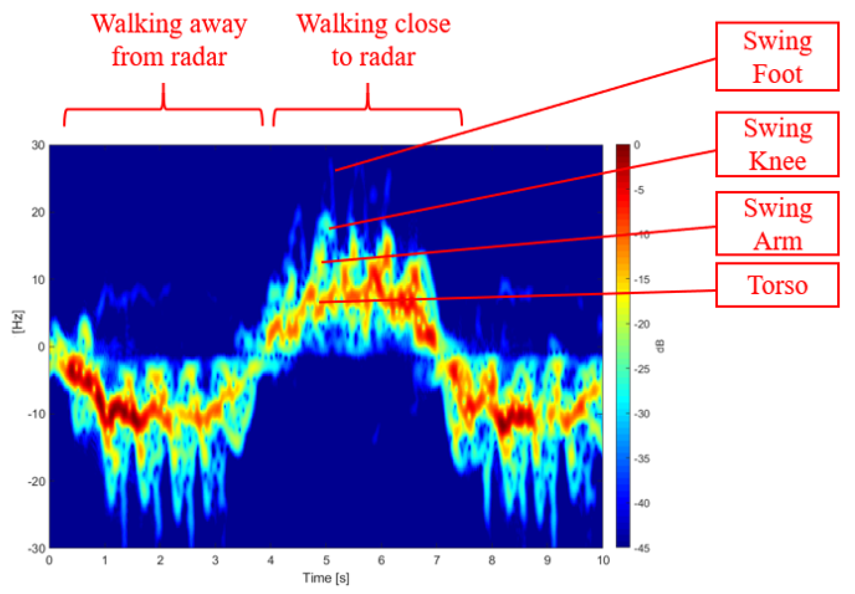
Not only can a spectrogram be generated by sound - but also, for example, by radar:

Slide 14
A SONOGRAM (or SONOGRAPH)
is specifically
a spectrogram of sound waves.

Slide 15
However, to complicate things,
the term sonogram
these days is mainly used for
medical ultrasound images -
where Ultrasound is an imaging method
that uses sound waves to produce
images of something within the body.
Notes:
Ultrasound uses high frequency sound waves.

Slide 16
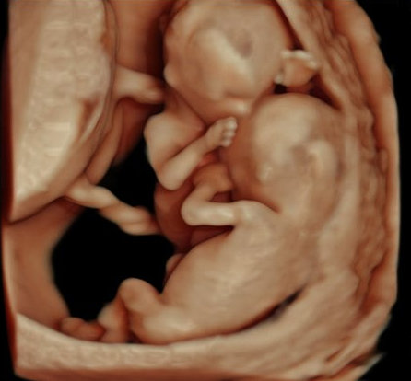
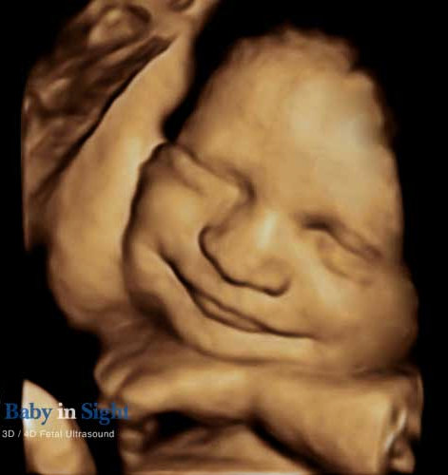
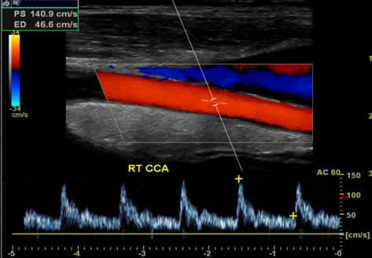
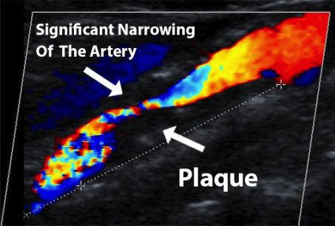
Corotid
Artery

Slide 17
In this presentation,
the term sonogram
will be used in the more
traditional sense –
when sonograms were first used in the
1940s for bird songs –
to mean a spectrogram of sound waves.

Slide 18
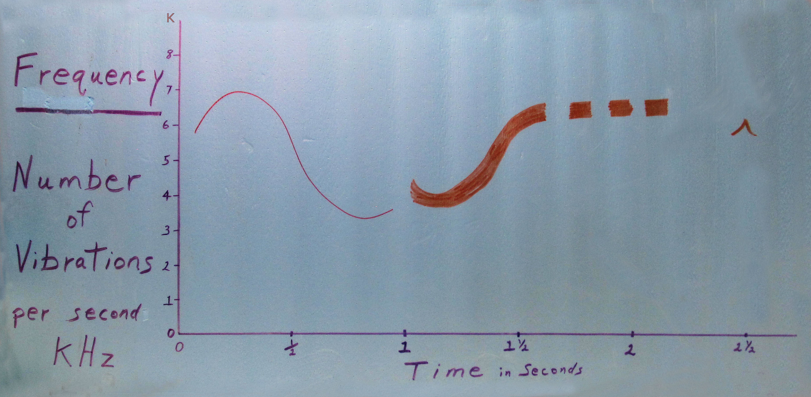
(Back to Handout)
Sonogram
(Back to Handout)

Slide 19
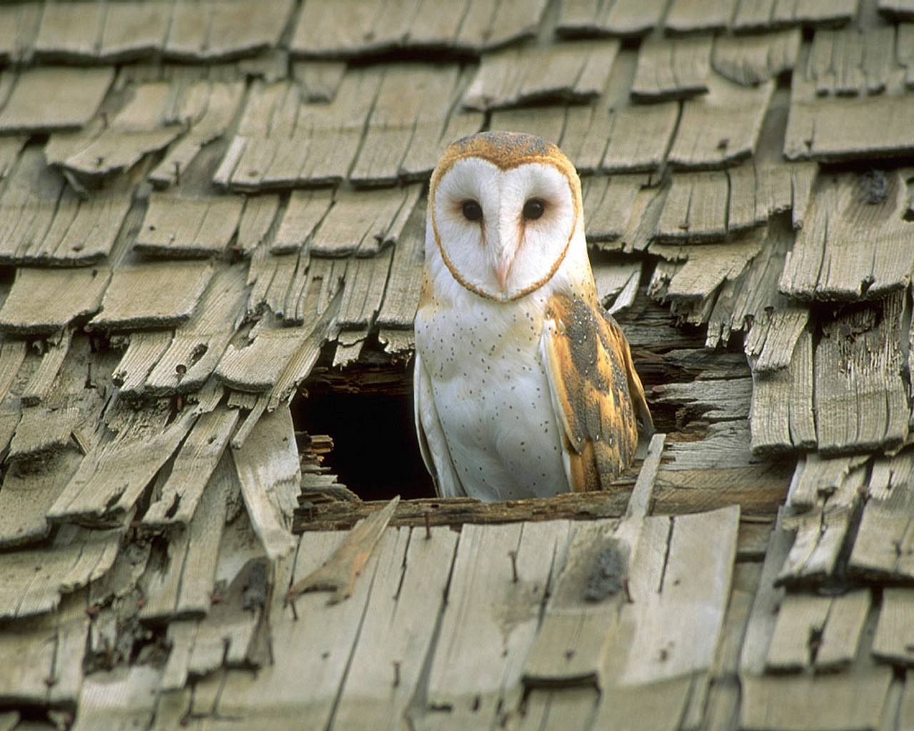

Barn Owl

Slide 20
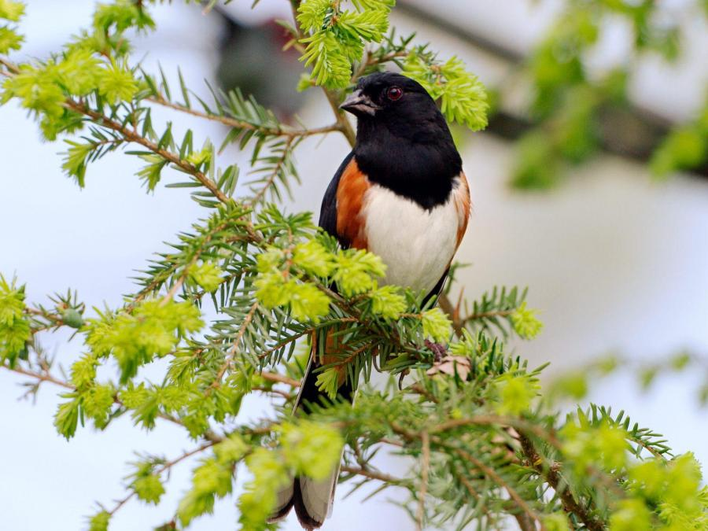
Rufous-sided Towhee

Slide 21
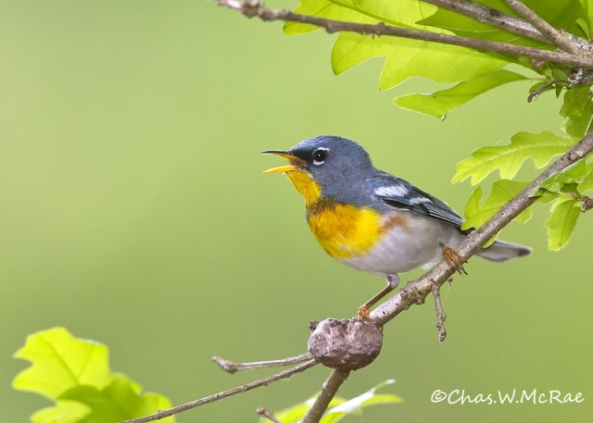
Parula Warbler

Slide 22
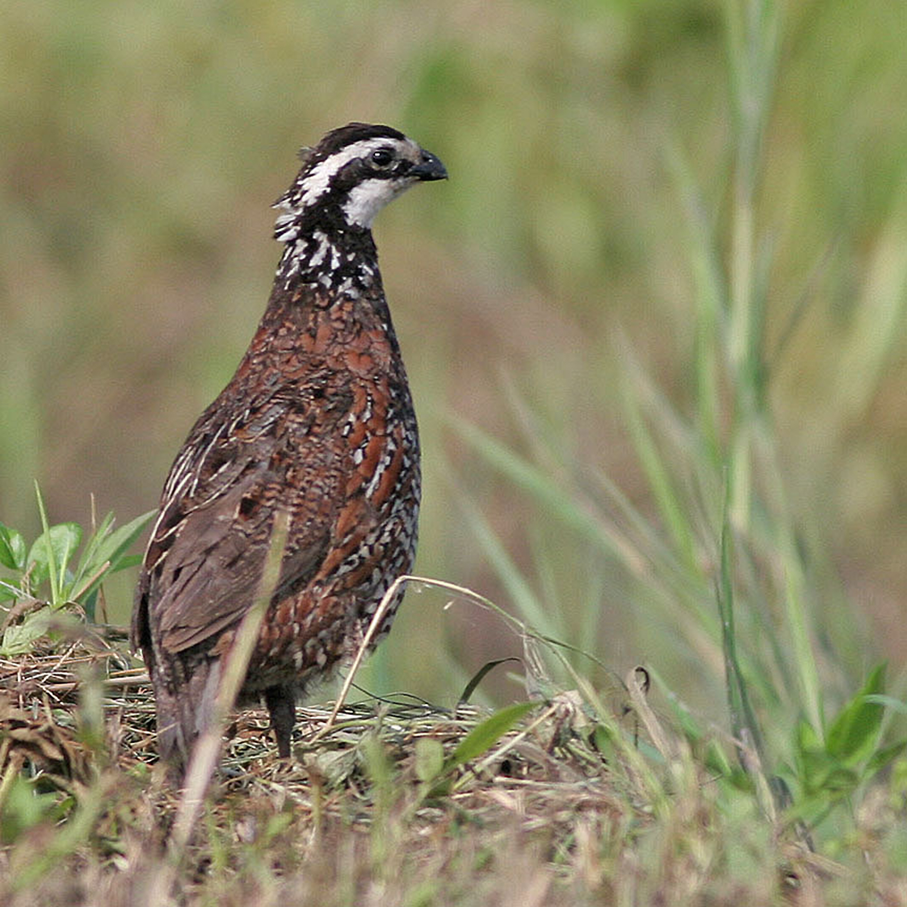
Common Bobwhite

Slide 23
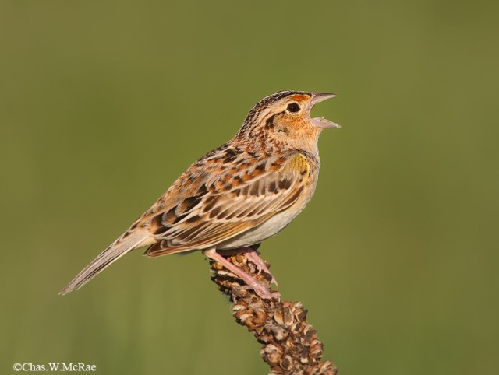
Grasshopper Sparrow

Slide 24
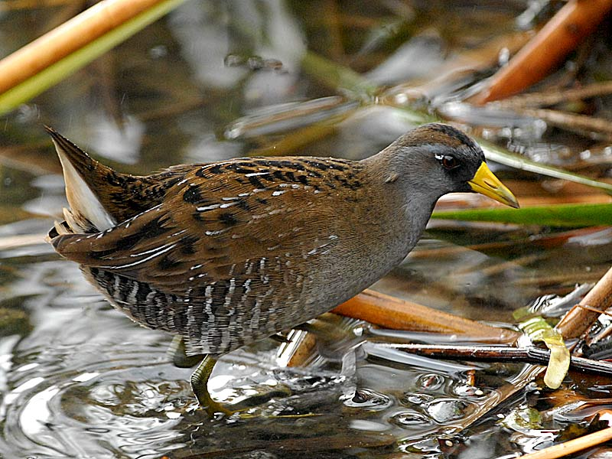
Sora

Slide 25
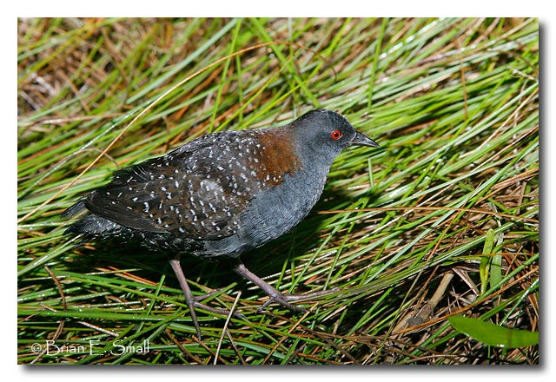
Black Rail

Slide 26
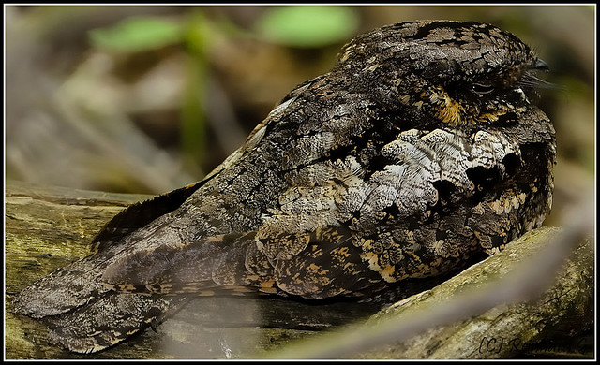
Whip-poor-will

Slide 27
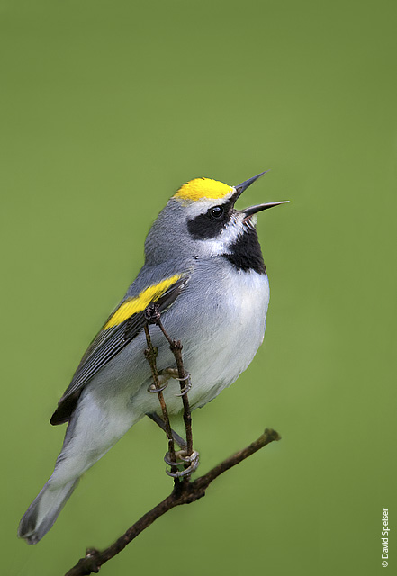
Golden-winged Warbler

Slide 28
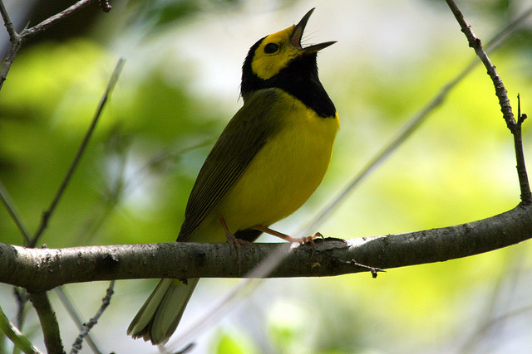
Hooded Warbler

Slide 29
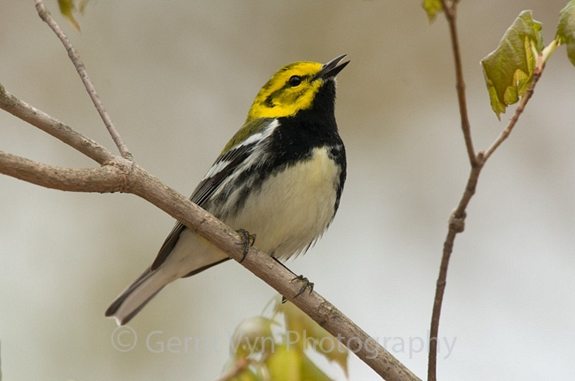
Black-throated Green Warbler

Slide 30
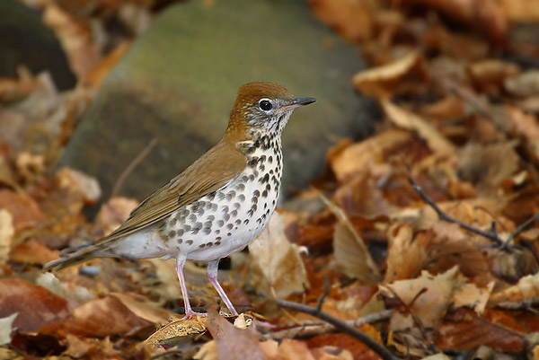
Wood Thrush

Slide 31
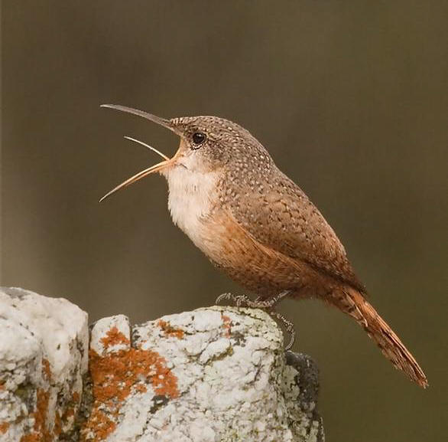
Canyon Wren

Slide 32
All bird songs repeated:

Slide 33
Be Aware
of Your Environment!
If you look more carefully,
you will see more!
If you listen more carefully,
you will hear more!

